Slide 1
Database management systems
lecture 13. The Database Connectivity

Slide 2
Database Connectivity
Database middleware: Provides an interface between the application program and the database
Data repository - Data management application used to store data generated by an application program
Universal Data Access (UDA): Collection of technologies used to access any type of data source and manage the data through a common interface
ODBC, OLE-DB, ADO.NET form the backbone of MS UDA architecture

Slide 3
Native SQL Connectivity
Connection interface provided by database vendors, which is unique to each vendor
Interfaces are optimized for particular vendor’s DBMS
Maintenance is a burden for the programmer

Slide 4
ODBC, DAO, and RDO
Open Database Connectivity (ODBC):Microsoft’s implementation of a superset of SQL Access Group Call Level Interface (CLI) standard for database access
Widely supported database connectivity interface
Allows Windows application to access relational data sources by using SQL via standard application programming interface (API)

Slide 5
ODBC, DAO, and RDO
Data Access Objects (DAO): Object-oriented API used to access MS Access, MS FoxPro, and dBase databases from Visual Basic programs
Provides an optimized interface that expose functionality of Jet data engine to programmers
DAO interface can be used to access other relational style data sources

Slide 6
ODBC, DAO, and RDO
Remote Data Objects (RDO)
Higher-level object-oriented application interface used to access remote database servers
Dynamic-link libraries (DLLs)
Implements ODBC, DAO, and RDO as shared code that is dynamically linked to the Windows operating environment

Slide 7
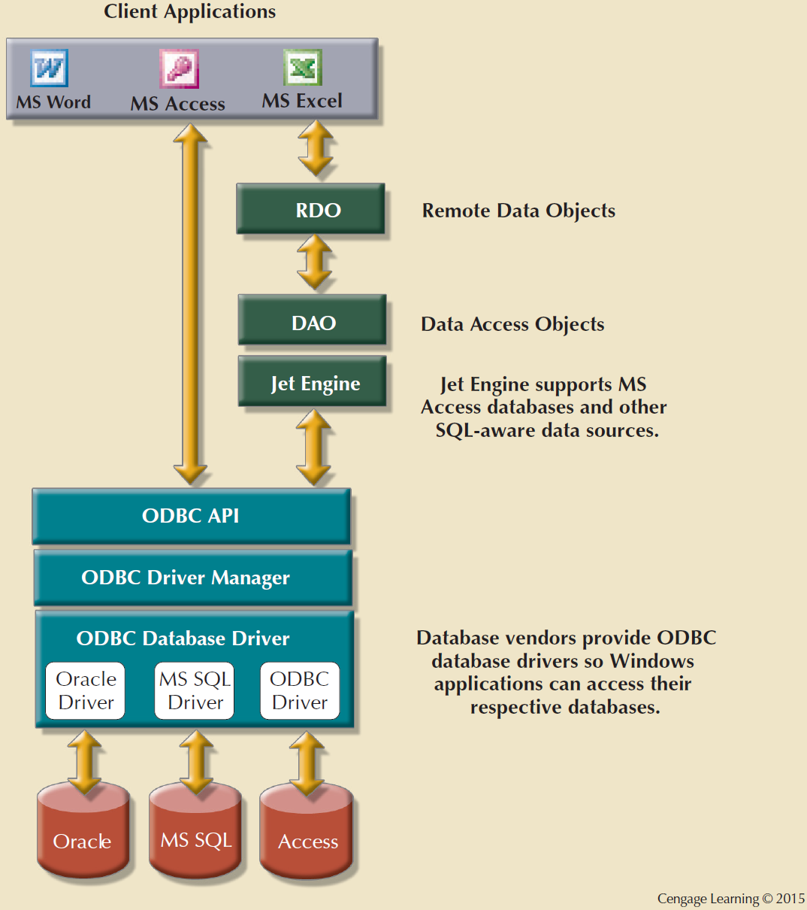
Using ODBC, DAO, and RDO to access databases

Slide 8
Components of ODBC Architecture
High-level ODBC API through which application programs access ODBC functionality
Driver manager that is in charge of managing all database connections
ODBC driver that communicates directly to DBMS

Slide 9
Object Linking and Embedding for Database (OLE-DB)
Database middleware that adds object-oriented functionality for access to data
Series of COM objects provides low-level database connectivity for applications
Types of objects based on functionality
Consumers
Providers

Slide 10
Object Linking and Embedding for Database (OLE-DB)
Does not provide support for scripting languages
ActiveX Data Objects (ADO): Provides:
High-level application-oriented interface to interact with OLE-DB, DAO, and RDO
Unified interface to access data from any programming language that uses the underlying OLE-DB objects

Slide 11
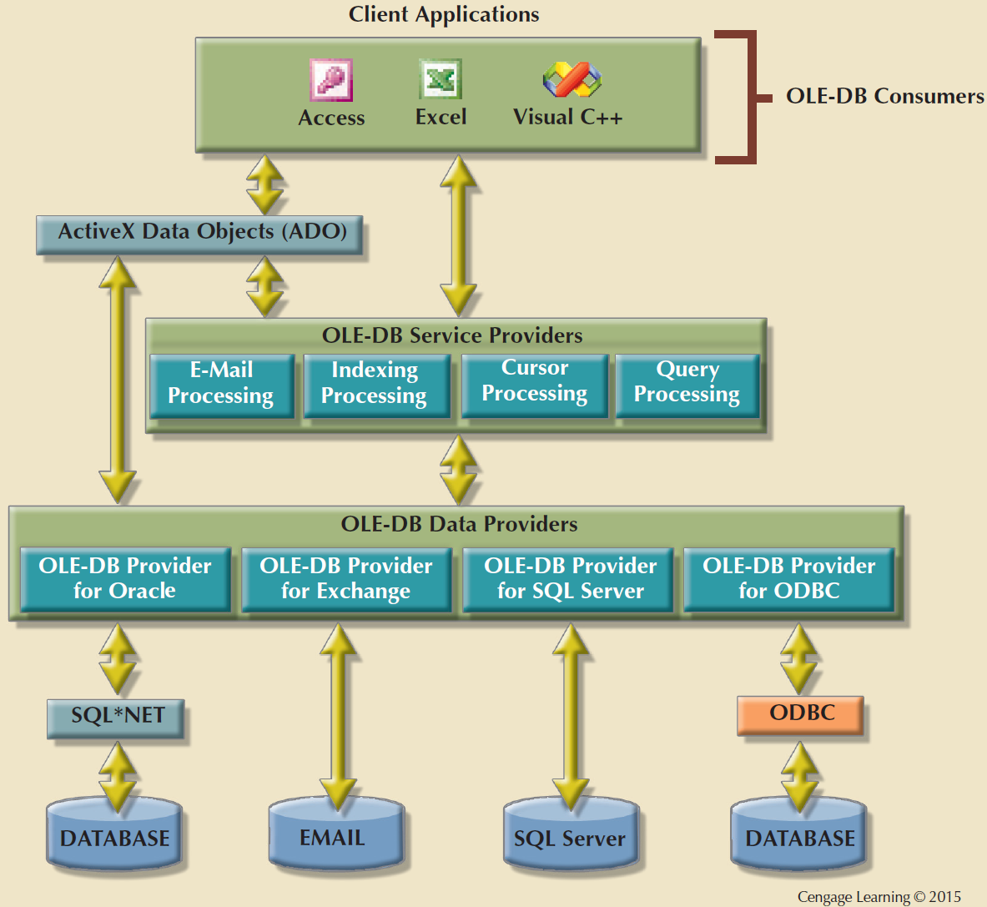
OLE-DB Architecture

Slide 12
ADO.NET
Data access component of Microsoft’s .NET application development framework
Microsoft’s .NET framework
Component-based platform for developing distributed, heterogeneous, interoperable applications
Manipulates any type of data using any combination of network, operating system, and programming language

Slide 13
ADO.NET
Features critical for the development of distributed applications
DataSet: Disconnected memory-resident representation of database
XML support
DataSet is internally stored in XML format
Data in DataSet is made persistent as XML documents
DataSet is internally stored in XML format
Data in DataSet made persistent as XML documents

Slide 14
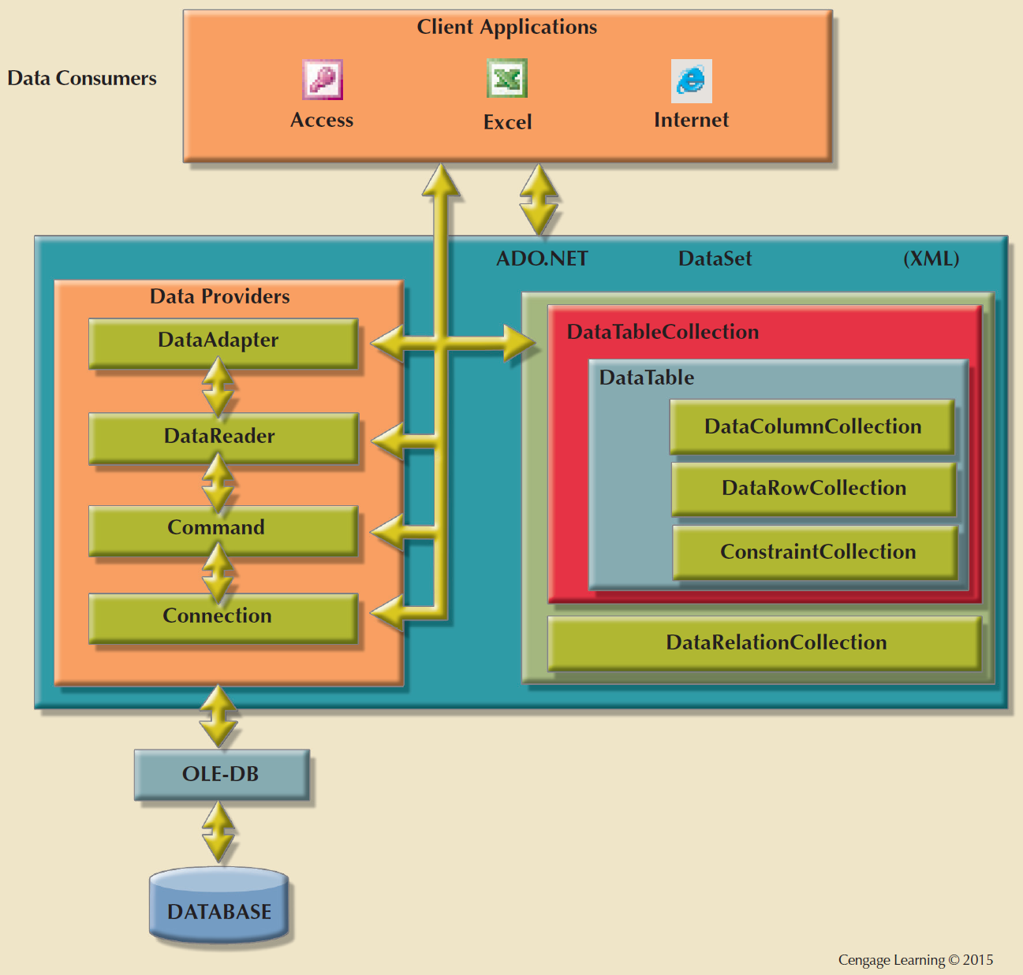
ADO.NET Framework

Slide 15
Java Database Connectivity (JDBC)
Java: Object-oriented programming language that runs on top of web browser software
Application programming interface that allows a Java program to interact with a wide range of data sources

Slide 16
Advantages of JDBC
Company can leverage existing technology and personnel training
Allows direct access to database server or access via database middleware
Allows programmers to use their SQL skills to manipulate the data in the company's databases
Provides a way to connect to databases through an ODBC driver

Slide 17
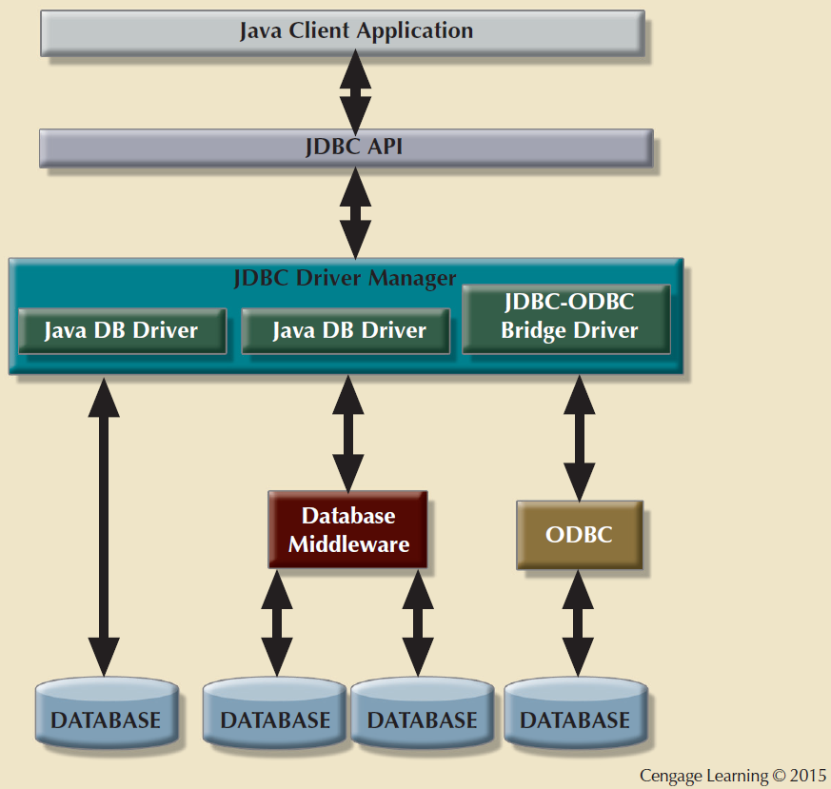
JDBC Architecture

Slide 18
ODBC Solution
Requirements
Access Multiple DBMSs
using same source code without recompiling and relinking
Simultaneously
Which DBMS features should ODBC expose ?
Common to all DBMSs
Any feature that is available in any DBMS
Solves
It is a Call Level Interface(CLI)
Defines Standard SQL Grammar
Driver Manager -> simultaneous access to multiple DBMSs
Feature Set

Slide 19
ODBC Architecture
Application
ODBC API
Driver Manager
ODBC API
Driver
Driver
Driver
Driver
Data
Source
Data
Source
Data
Source
Data
Source

Slide 20
Connector/ODBC
Connector/ODBC is a MySQL ODBC Driver
Also known as MyODBC
Conforms to ODBC 3.51 specification, level 1 (complete core API + level 2 features)
Works on all major Operating Systems

Slide 21
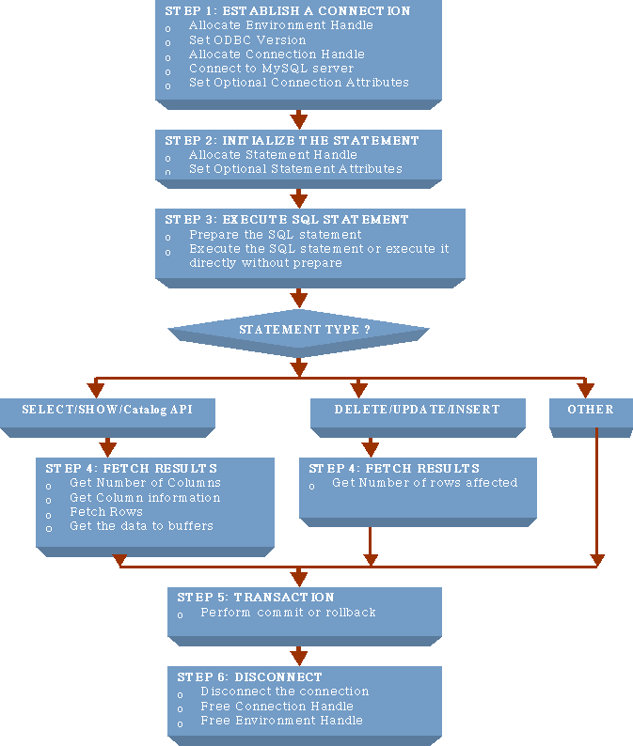

Slide 22
Data Source Name
What is a Data Source Name (DSN) ?
Types
Machine Data Source
User Data Source
System Data Source
File Data Source
What does Connector/ODBC DSN contain ?
Username (UID) | Password (PWD) | Server
Database | Port | Socket
Options | Stmt | DSN
Description

Slide 23
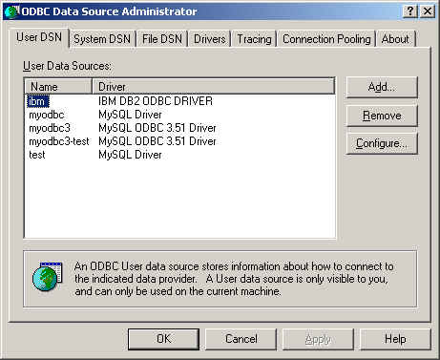
Setting up a DSN on Windows

Slide 24
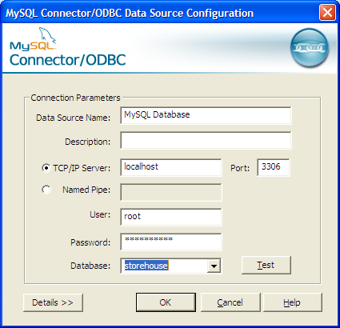
Setting up a DSN on Windows (cont ..)

Slide 25
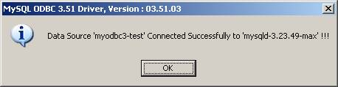
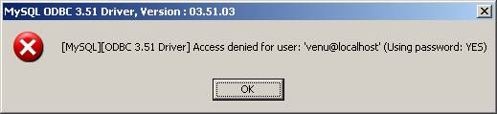
Test Data Source

Slide 26
Products that works with Connector/ODBC
MS Access | OpenOffice | Delphi
CTD | ColdFusion | Crystal Reports
Erwin | MS Office tools | FileMaker Pro
FoxPro | Notes 4.5/4.6 | MS Visio Enterprise
Vision | Visual Objects | Visual Interdev
Perl DBD-ODBC | ParaDox | PowerBuilder
PowerDesigner | ODBC.NET | SQLExpress
StarOffice | Samba Server | ….

